Slide 2
The External Economic Action of the European Union and the Sustainable Development Goals
Filippo Fontanelli – University of Edinburgh – filippo.fontanelli@ed.ac.uk
University of Bologna
3 May – 25 May
11 May 2023
CBAM

Slide 3
Outline of the module (in progress)
The course’s basic coordinates
  Trade law, investment law and sustainable development: basic notions
  EU competences and policies in trade and investment law
Trade/investment obligations and non-trade values: the return of unilateralism
  The backlash against investor-State arbitration.
  The backlash against trade liberalisation
  Reform proposals for the global investment and trade regimes
  An overview of re-nationalisation trends in trade an investment (US, EU, UK, China)
    Anti-coercion
    Anti-circumvention
    Retaliate against non-MPIA
    Steel row, now sustainable
EU’s external economic action to raise standards abroad
  Free trade agreements and non-economic standards
    Conflict mineral regulation (sort of like diamonds)
    2022 commitment to green trade partnership
    Deforestation MERCOSUR
  Zoom-in: EU dispute with Korea on labour rights
  Zoom-in: level playing field and sustainable development in the Trade and Cooperation Agreement between the EU and the UK
    Mirror clauses
The Carbon Border Adjustment Mechanism
  Overview and assessment of the scheme
  Compatibility with WTO law (China’s complaint at WTO)
  Bonus: carbon removal
Energy (trade)
  EU Net Zero Industry Act and support to renewable energy industry (with assessment of WTO compatibility)
  Reaction to comparable foreign plans (US IRA)
  Zoom-in: biofuels and e-fuels
Energy (investments)
  Foreign investment protection and the fossil fuels industry
  Foreign investment protection and the nuclear energy industry
  Foreign investment protection and the renewable energy industry
  The Energy Charter Treaty, its reform attempts and the withdrawal of EU MS
Controlling trade and investment inbound and outbound flows
  Export restrictions and export controls (including coordinated action with US)
  Critical Raw Materials Act
  EU investment screening
Improving supply chains’ sustainability
  Friend-shoring and sustainable value chains
  Global supply chain due diligence proposal
  EU Guidance to Combat Forced Labor in Supply Chains
  Responsible forestry proposal (trade in forest-risk commodities)
  WTO law-compatibility of these schemes
Promotion of other social interests
  Non-paper of the Commission services 2017 TSD chatpers
  Gender balance in corporate governance in FTAs
  Protection of indigenous peoples’ rights
UNA Europa presentation

Slide 4

Presentations?
For last session, or thematic input into sessions 5 to 9.
Just drop me an email at filippo.fontanelli@ed.ac.uk

Slide 5

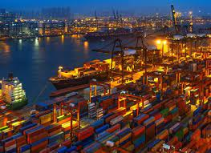

Carbon Border Adjustment Mechanism
CBAM – the proposal and the final scheme
Carbon Removal
Emission Trading System
Carbon Leakage
UNA Europa presentation

Slide 6
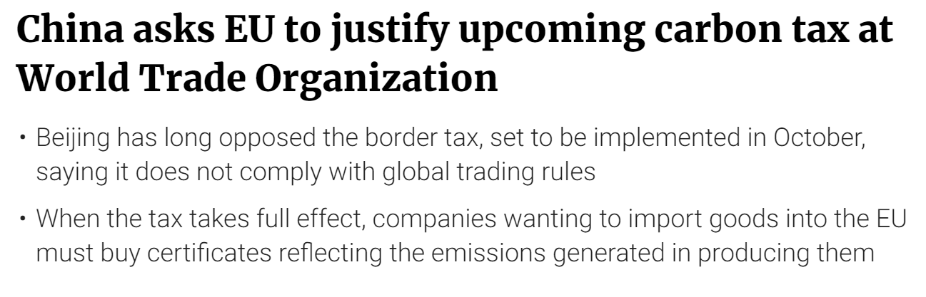
ETS and CBAM, what is going on?
UNA Europa presentation

Slide 7


Slide 8

Green Deal and 55% goal
The 2020 Green Deal aims to reduce emissions from greenhouse gas (GHG) by 55% before 2030 (on 1990 levels) and achieve carbon neutrality by 2050
UNA Europa presentation

Slide 9
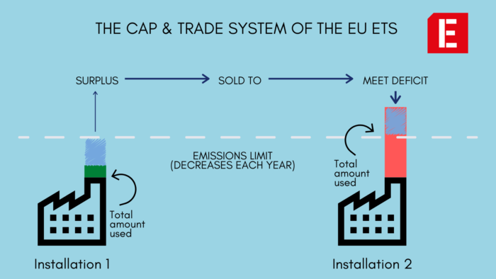
Emission Trading Scheme

Slide 10
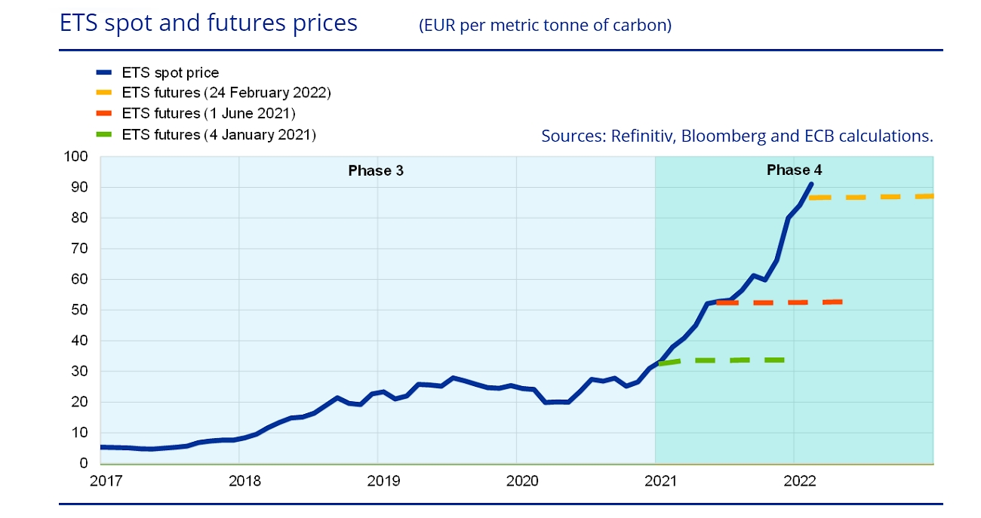
Trade in Emission Certificates
UNA Europa presentation

Slide 11
Carbon Leakage

Slide 12
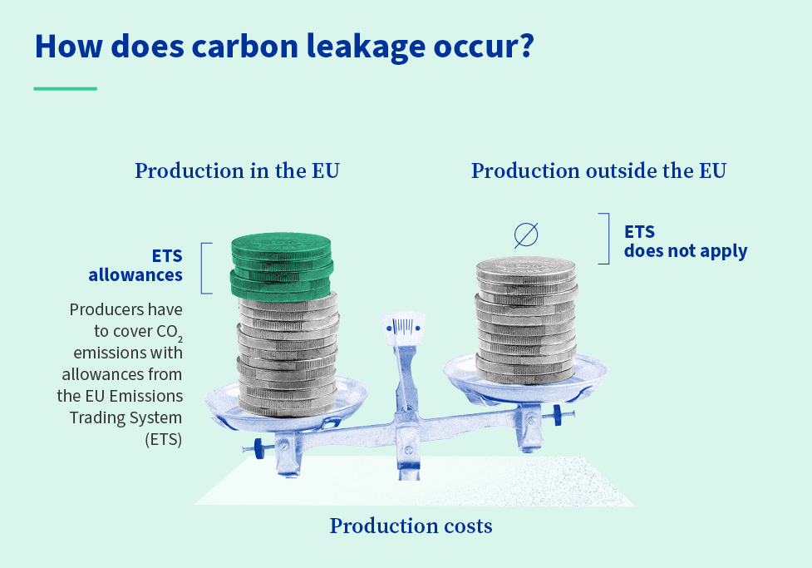
Carbon Leakage

Slide 13
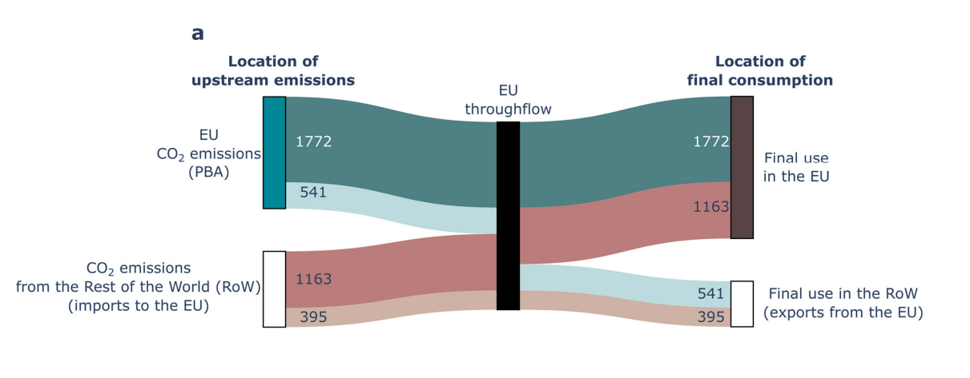
Carbon flows

Slide 14

Free allowances
Alongside reduction for electricity prices
Counterproductive for ETS’s goal (55% reduction)
UNA Europa presentation

Slide 15
CBAM
Part of fit for 55 package
Adopted in April 2023, signed yesterday
Like BTaxAs: (BTAs), taxes using the destination principle: paid where products are consumed and not where they are produced

Slide 16
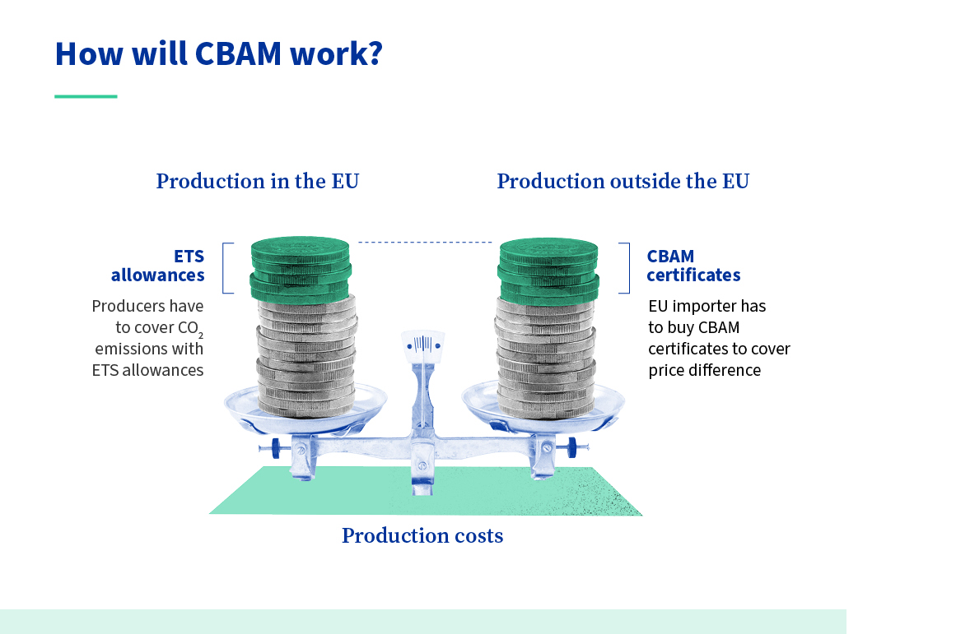
Counter the leakage

Slide 17
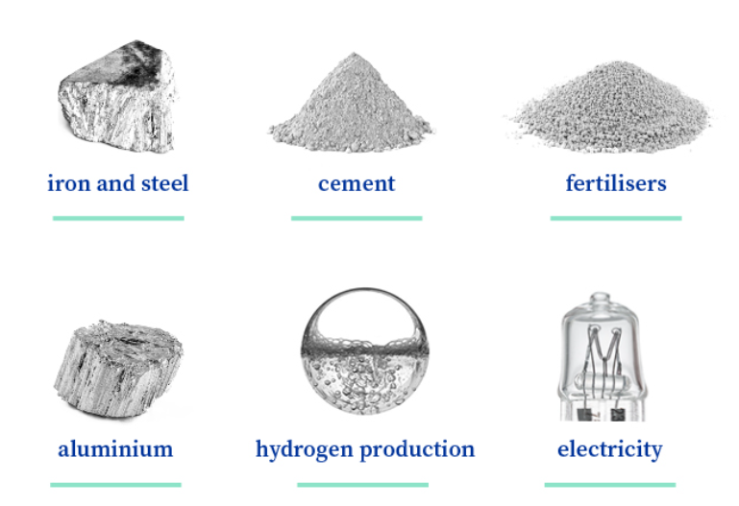
Coverage (initial scope)
No gas/oil, aviation, agriculture (also excluded from ETS, so not eligible)

Slide 18
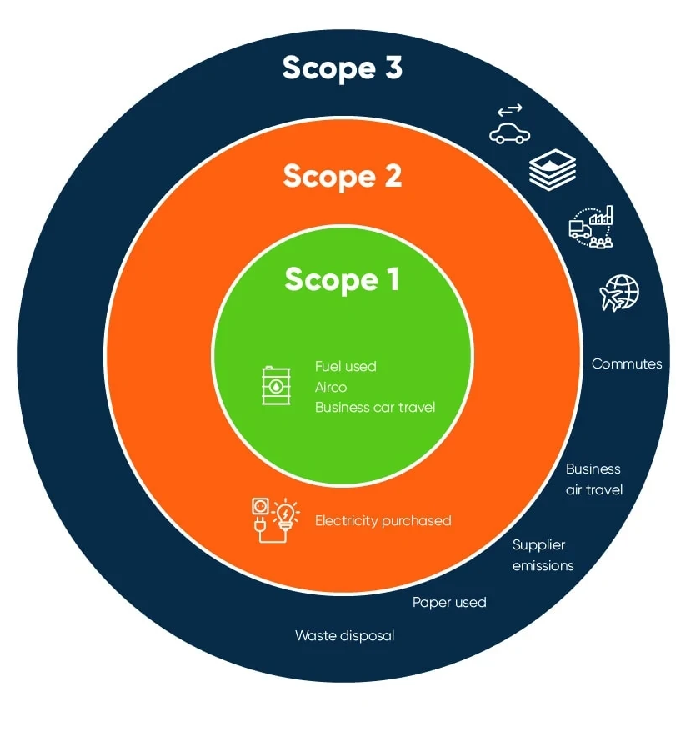
Emissions
“direct” or “scope 1 emissions” (directly related to the production process of goods over which the producer has direct control) COVERED
“indirect” or “scope 2 emissions” (deriving from electricity used during the production) COVERED IN PART
“value chain” or “scope 3 emissions,” (e.g., emissions from transportation and distribution) NOT COVERED
UNA Europa presentation

Slide 19
Pathway Forwards
Inclusion of indirect emissions
Full Implementation
Iron and steel
Cement
Aluminium
Fertilisers
Electricity
2035
Initial Implementation
2026
Transition Reporting
Support for Least Developed Countries
Q3 2023
Expansion of covered goods (chemicals & polymers)
Negotiation
Internally within the EU
Externally with Partners
Source: Johnstone’s ImprovEUorGlobe webinar 21 April 2023

Slide 20
CBAM Importer: A Year in the Life
Declare
3
The number of imported goods and their embedded emissions annually, establish any price already paid per ton.
Compliance
5
Develop and maintain the necessary documentation.
.
Import Goods
2
Liaise with suppliers to gather emissions information on goods imported.
Obtain
4
And surrender the necessary amount of CBAM certificates by May 31 of the following calendar year.
Register
1
With the national authorities before importing the goods.

Slide 21

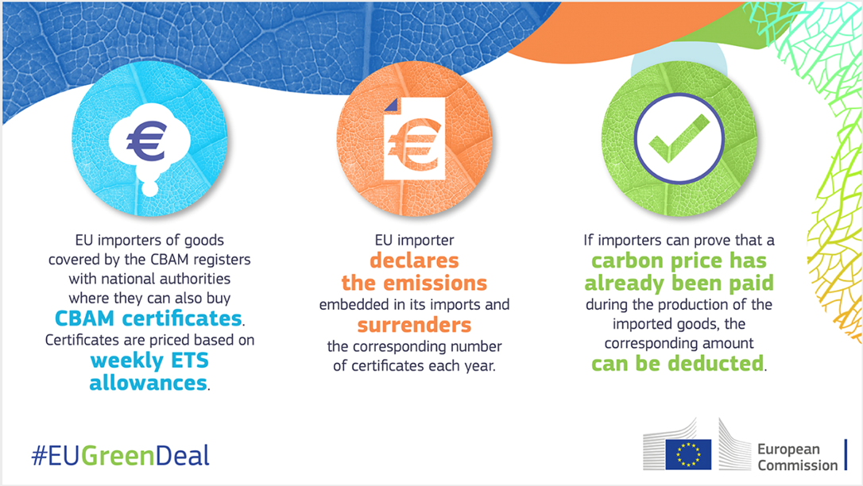
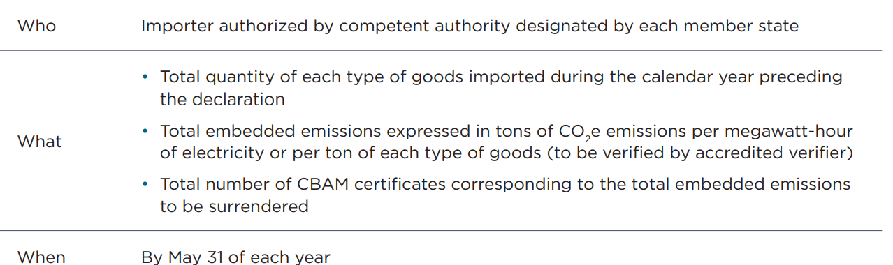
Operation

Slide 22

Export rebates?
To level playing field for EU goods competing on world market (primary goal is competitiveness, not climate action)
Clash between Commission and Parliament (in the form of free allowances)
UNA Europa presentation

Slide 23

Trade effects?

Slide 24
Shared but differentiated responsibilities?
CBAM not perfectly aligned with assisted transition to low-carbon

Slide 25
WTO law check
Border measure?
Border effect of domestic measures (Asbestos, Seals, Shrimps) – discrimination? Arts I and III
Tariff? Art III
Export subsidy?
(ETS free allowance a countervailable subsidy?)
UNA Europa presentation

Slide 26

Who’s happy/unhappy?
Risk of differential treatment
  Country-based
  Exemption
  Carbon price vs other carbon-reduction costs
UNA Europa presentation

Slide 27
Article XX(g)
Is it related to the conservation of exhaustible natural resources?
Is it applied in conjunction with domestic restrictions?
Does it result in unjustifiable discrimination between similar situations?

Slide 28
Export rebates as subsidies
Export rebate: is it a ‘financial contribution’ by the European Union in the form of ‘government revenue that is otherwise due’ [some form of carbon cost] which is ‘foregone or not collected’ contingent on exporting the product?
Article 3.1 SCM

Slide 29
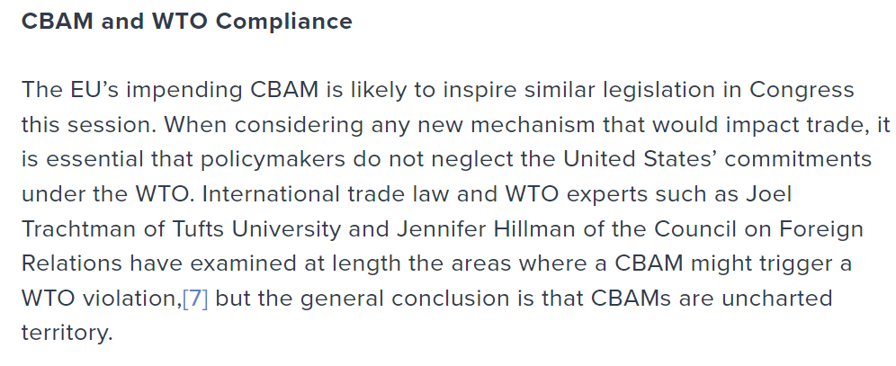
What now?

Slide 30
@una_europa
#Una_Europa
Thanks!

